Slide 1

Covid-19 and the NYC Apartment Market
Jack Copeland

Slide 2
Outline
Background Information
Research Question
Data Analysis
Conclusion
Future Work/Next Steps

Slide 3
Outline
Background Information
Research Question
Data Analysis
Conclusion
Future Work/Next Steps

Slide 4
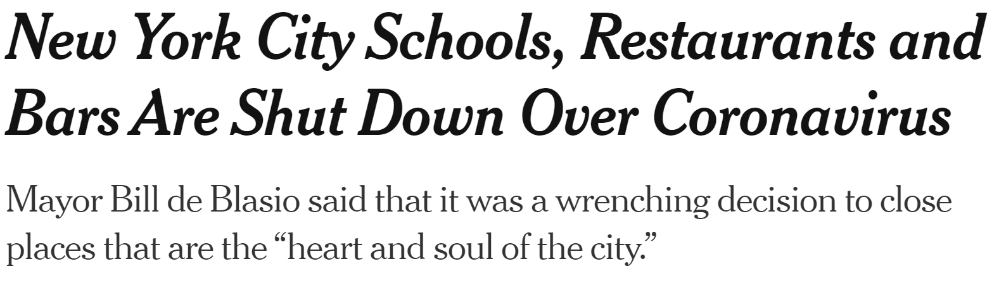


Covid-19 Pandemic in NYC
January 2021
I start my search for an apartment
March 1st, 2020
March 15th, 2020
March 27th, 2020
Oct 15th, 2021
First Covid Case in NYC
Schools, Bars, and Restaurants Closed
US Reaches Most Covid Cases in World
Nearly 2.5 Million Covid Cases in NYC

Slide 5
Outline
Background Information
Research Question
Data Analysis
Conclusion
Future Work/Next Steps

Slide 6



Research Questions
#1
#2
#3
How drastically did Covid affect apartment rental rates? Have rates fully recovered?
Which areas in New York City experienced the largest change in rates?
Can characteristics of each area predict how rates will be affected?

Slide 7
Outline
Background Information
Research Question
Data Analysis
Conclusion
Future Work/Next Steps

Slide 8
Data Sources
NYT Covid Data
Street Easy
US Census Data
Attributes:
Number of daily cases
7 Day avg of cases
Broken out by Borough and total NYC
Timeframe:
March 2020 through present
Source: Link Here
Attributes:
Median Rent
Number of Discounted Apartments
Share of Discounted Apartments
Timeframe:
January 2010 through present
Source: Link Here
Attributes:
Population
Population under 18
Number of occupied housing units
Number of vacant housing units
Timeframe:
2020
Source: Link Here

Slide 9
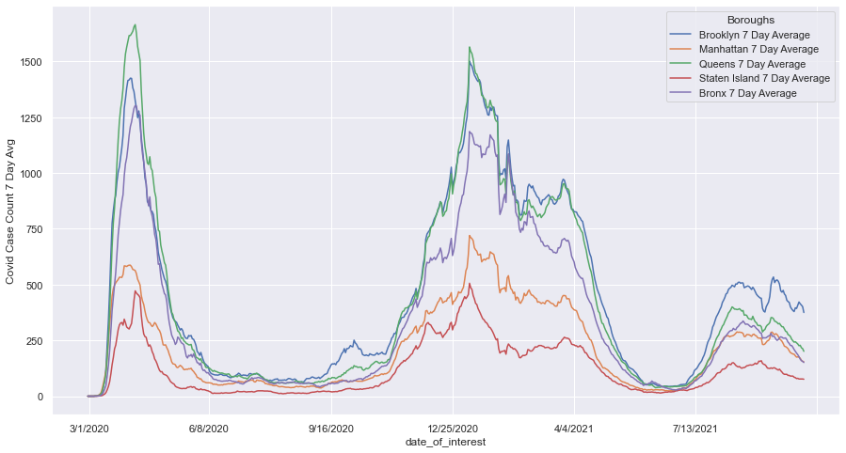
Covid Data
Key Takeaways:
Covid Start Date in NYC is listed as March 1st
Covid Peak in NYC is in January 2021
Queens and Brooklyn saw the highest number of cases of Covid
Staten Island and Manhattan experienced the lowest numbers of the five boroughs

Slide 10
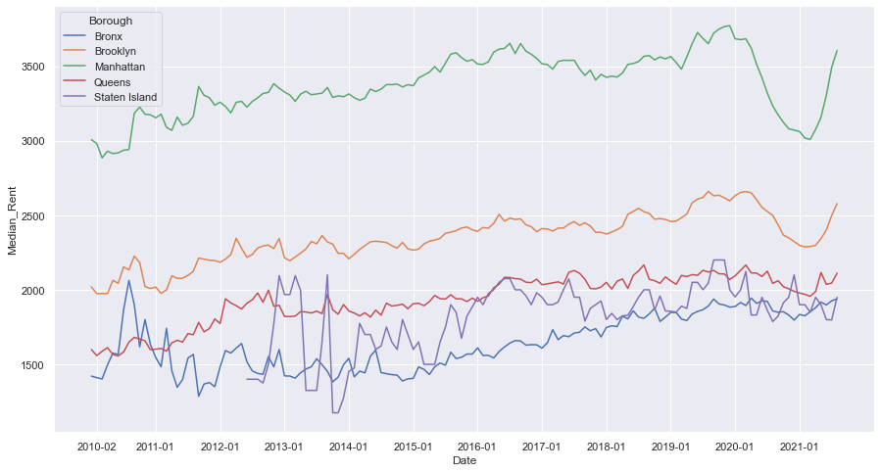
Street Easy Median Rent Data
Key Takeaways:
Rents were increasingly consistently from 2010 through the beginning of 2020
After the first Covid case in NYC (marked by the red line), rents started dropping significantly for Manhattan and Brooklyn

Slide 11
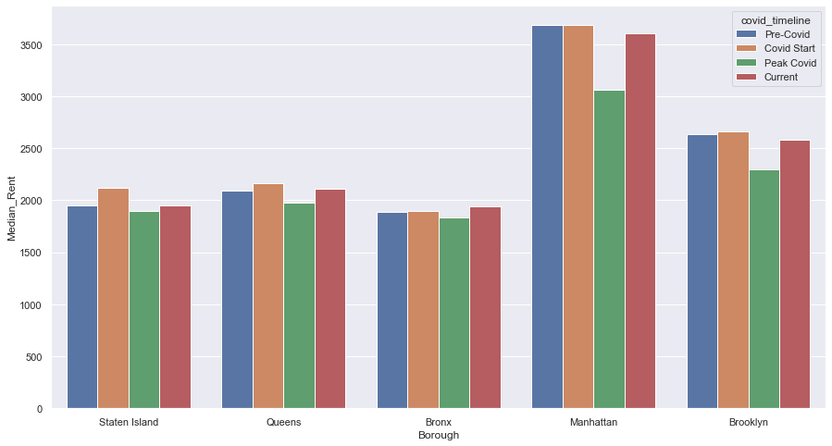
Street Easy Rent Data
Key Takeaways:
Rents dropped significantly in Brooklyn and Manhattan
The other three boroughs only saw a slight decrease in rent
Currently, most boroughs have completely recovered to pre-covid rents

Slide 12
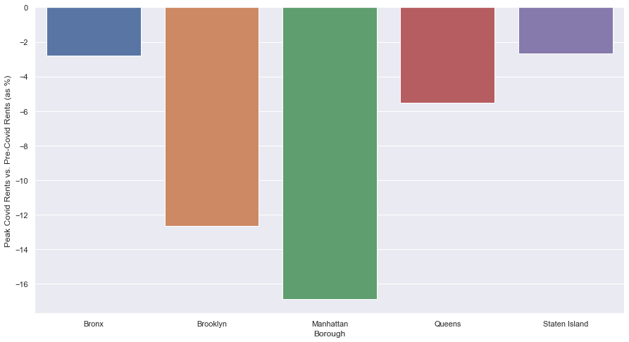
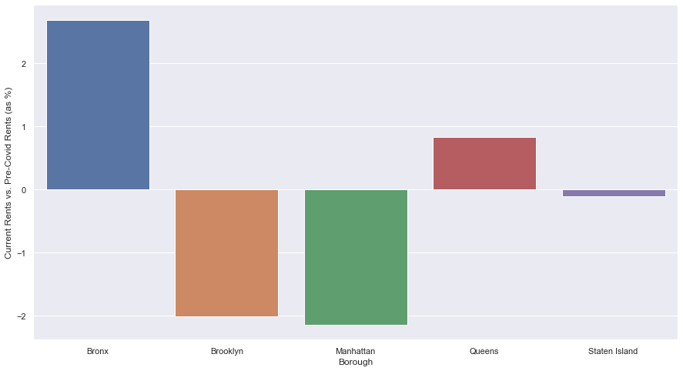
Street Easy Rent Data
Percent Change in Rent by Borough (Peak Covid vs. Pre Covid)
Percent Change in Rent by Borough (Current rates vs. Pre-Covid)

Slide 13
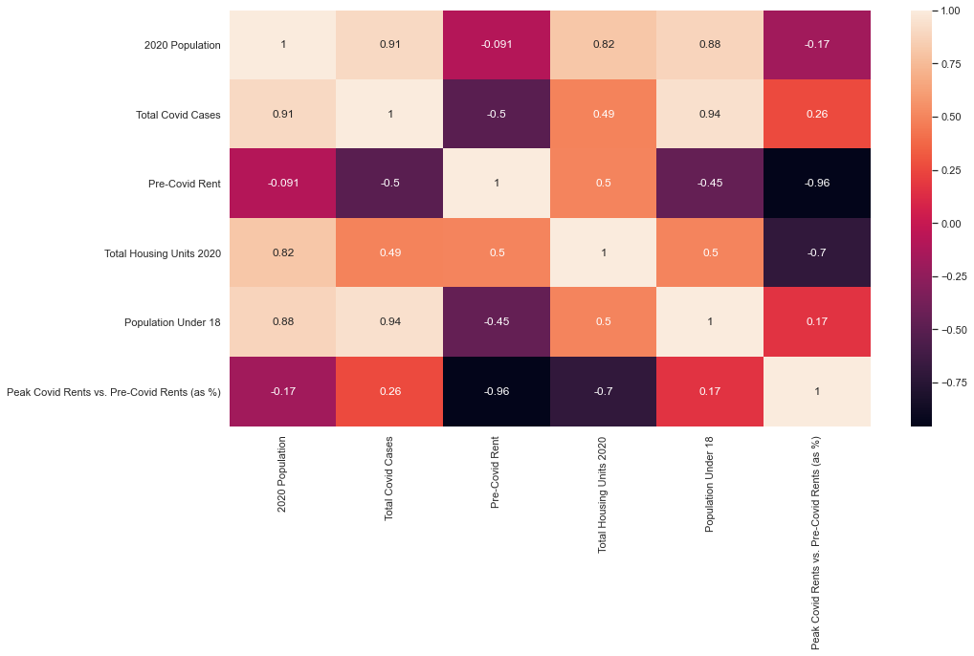
Factors affecting changes
Key Takeaways:
Highest correlations to drop in rental prices:
Pre-Covid Rent
The more expensive, the greater the decline
Total Housing Units in 2020
Lowest correlations to drop in rental prices:
Total Covid cases
Population under 18

Slide 14
Outline
Background Information
Research Question
Data Analysis
Conclusion
Future Work/Next Steps

Slide 15
Conclusions
How drastically did Covid affect apartment rental rates? Have rates fully recovered?
Which areas in New York City experienced the largest change in rates?
Can characteristics of each area predict how rates will be affected?
Percent Change at Peak Cases
Current Rates vs. Pre-Covid
Borough | Peak vs. Pre | Current vs. pre
Bronx | -2.81% | +2.68%
Brooklyn | -12.66% | -2.02%
Manhattan | -16.87% | -2.14%
Queens | -5.51% | +0.83%
Staten Island | -2.66% | -0.10%
Most important factors
Least important factors
Pre-Covid Median Rent
Total Housing Units
2020 Population
Total Covid Cases
Population under 18
-9.59%
-0.01%

Slide 16
Outline
Background Information
Research Question
Data Analysis
Conclusion
Future Work/Next Steps

Slide 17
Next Steps
How drastically did Covid affect apartment rental rates? Have rates fully recovered?
Which areas in New York City experienced the largest change in rates?
Can characteristics of each area predict how rates will be affected?
Further Questions
Further Questions
Further Questions
Which type of apartments experienced the biggest changes?
Are there certain factors (such as sq footage, # of bedrooms, etc.) that can help predict recovery?
Will rents continue to increase in boroughs that have surpassed pre-covid median rents?
What other data can be incorporated to determine how areas will recover?
How can we increase the sample size for more accurate correlations?

Slide 18
Questions

